Slide 1
Machine Learning Algorithms
Osman Ramadan

Slide 2
Workshop Sessions
Pre-processing & Feature Extraction
Classification
Decision Trees and Random Forests
Support Vector Machines
Naïve Bayesian Classifier
Regression
Generalized Linear Models
Ridge Regression (Regularization)
Case study 1
Clustering
Dimensionality Reduction
Model Selection
Forecasting and Neural Network
Case study 2

Slide 3
Today’s Session Pre-processing
Introduction
Application
Examples
Exercise

Slide 4
Topics
Importing and Processing the data
Reading the data from CSV
Standardization
Normalization
Binarization
Encoding categorical
Imputation of missing
Generating polynomial features
Custom transformers
Visualising the data
Box Plots
Scatter Plots
Histograms
HeatMaps

Slide 5
Today’s Session Feature Extraction
Introduction
Application
Examples
Exercise

Slide 6
Topics
Feature Selection
Removing features with low variance
Univariate feature selection
Feature Extraction
Loading features from dicts
Feature hashing
Text feature extraction
Image feature extraction

Slide 7
Today’s Session Classification
Introduction
Application
Examples
Exercise

Slide 8
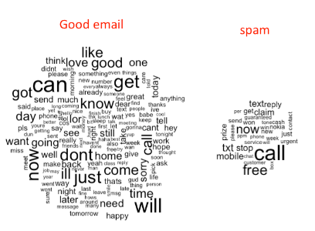
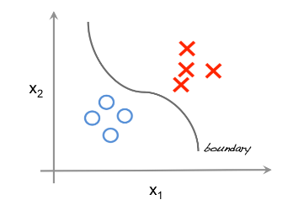
Classification
Outputs are discrete classes/categories
Applications in
Spam classifier
Image recognition
Speech recognition
Pattern recognition
Document classification

Slide 9
Topics
Decision Trees and Random Forests
Support Vector Machines

Slide 10
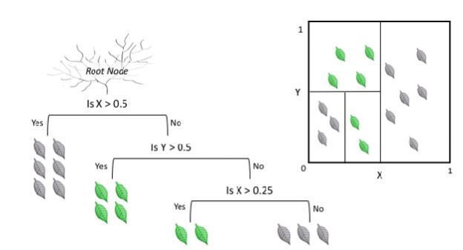
Decision Trees
Classification models in the form of a tree structure
Progressively splits the training set into smaller subsets
Each split in the data is made in order to minimise a misclassification metric (information gain, variance reduction)
Characterised by the number of splits or depth

Slide 11
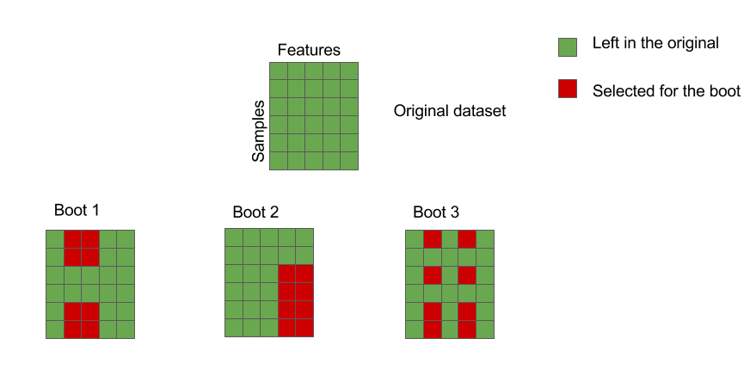
Random Forests
Ensemble learning (or modelling) involves the combination of several diverse models to solve a single prediction problem
It works by generating multiple models, which learn and make predictions independently
The random forests model is an ensemble method since it aggregates a group of decision trees into an ensemble
Random Forests use averaging to find a natural balance between high variance and high bias
Once many models are generated, their predictions can be combined into a single (mega) prediction using majority vote or averaging that should be better, on average, than the prediction made by the single models.
Characterised by the number of decision trees

Slide 12
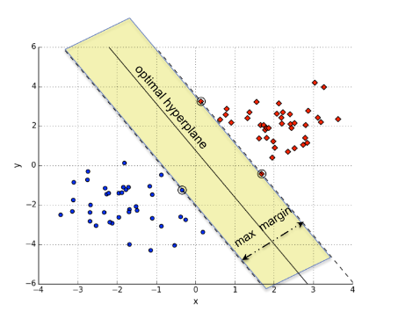
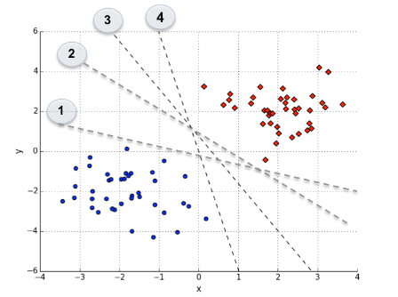
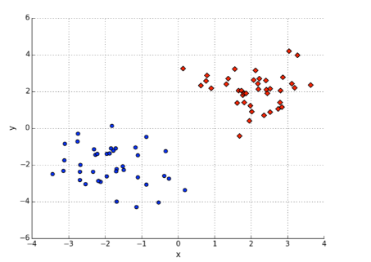
Support Vector Machines
SVM classifier attempts to construct a boundary that separates the instances of different classes as accurately as possible
There are multiple possible linear separators that can accurately separate the instances of the two classes
The core concept behind the success and the powerful nature of Support Vector Machines is that of margin maximisation
SVM classifier is entirely determined by a (usually fairly small) subset of the training instances - known as the support vectors

Slide 13
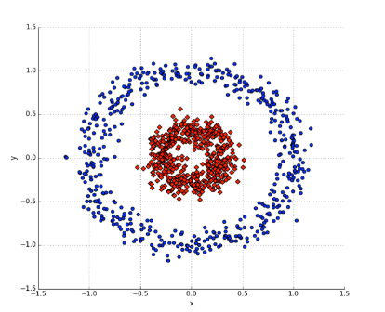
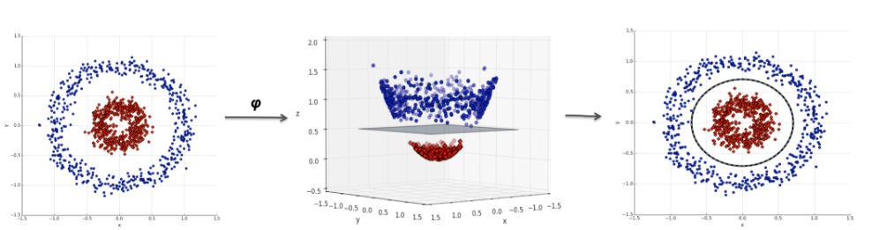
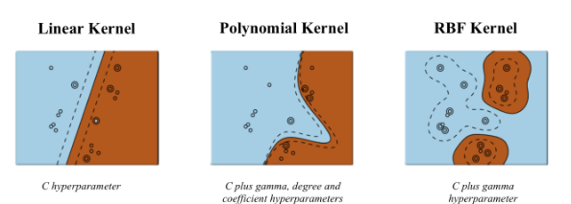
Non-linear SVM
The input space in this case cannot be separated well by a linear classifier
The data are mapped from the input space XX into a transformed feature space HH, where linear separation is potentially feasible using a non-linear function ϕ
The most commonly applied kernels are:
Gaussian Radial Basis Function (RBF)
Polynomial
Sigmoid

Slide 14
Workshop Sessions
Bayesian Algorithms
Clustering
Dimensionality Reduction
Neural Networks
Classification
Decision Trees and Random Forests
Support Vector Machines
Regression
Generalized Linear Models
Ridge Regression (Regularization)

Slide 15
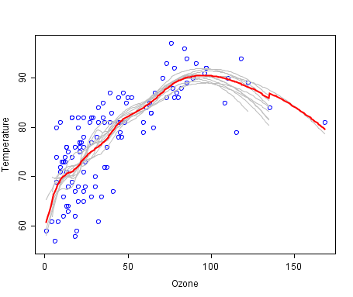
Regression
Data is labelled with a real value (think floating point) rather then a label
Regression models predict a value of the Y variable given known values of the X variables
Applications:
Price of a stock over time
Temperature predictions
Marketing
Population and growth

Slide 16
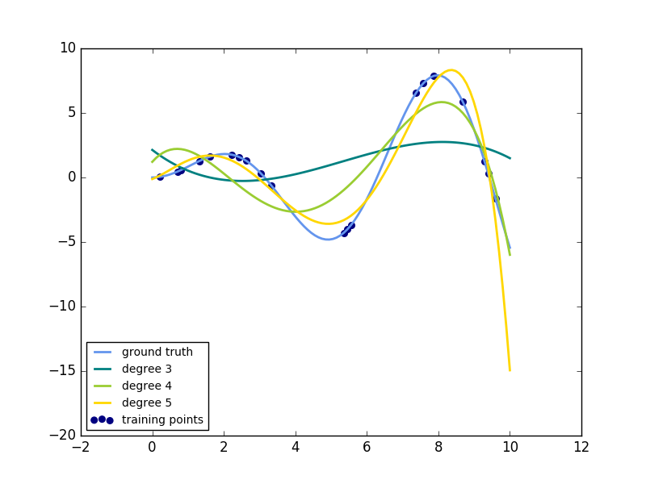
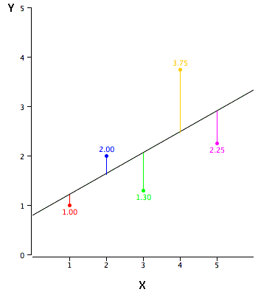
Linear Regression (Ordinary Least Squares)
The target value is expected to be a linear combination of the input variable
if is the predicted value then
The aim to find the coefficients that minimize the residual sum of squares between the observed responses and that predicted by linear approximation
Linear regression can be extended by constructing polynomial features from the coefficients
This is still a linear model, imagine creating a new variable

Slide 17
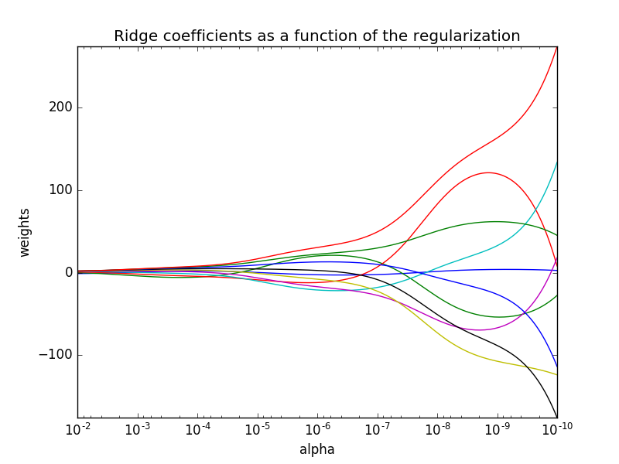
Ridge regression
Ridge regression addresses some of the problems of Ordinary Least Squares by imposing a penalty on the size of coefficients to minimize the variance
The ridge coefficients minimize a penalized residual sum of squares
α ≥ 0 is the complexity parameter that controls the amount of shrinkage: the larger the value of α, the greater the amount of shrinkage and thus the coefficients become more robust to collinearity

Slide 18
Workshop Sessions
Bayesian Algorithms
Clustering
Dimensionality Reduction
Neural Networks
Model Selection & Evaluation
Classification
Decision Trees and Random Forests
Support Vector Machines
Regression
Generalized Linear Models
Ridge Regression (Regularization)

Slide 19
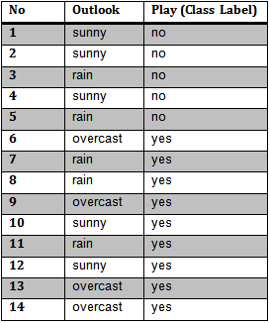
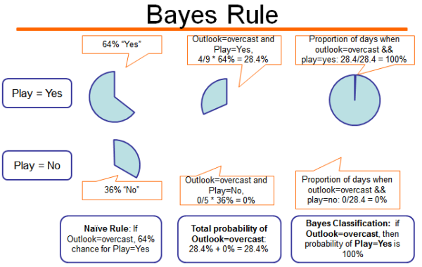


Bayesian Algorithms
Set of supervised learning algorithms based on applying Bayes’ theorem with the “naïve” assumption of independence between features
The classification rule is
They are very good for document classification and spam filtering
They require a small amount of training data to estimate the necessary parameters
They can be extremely fast compared to more sophisticated methods
Major drawback, they are known to be bad estimators
The different naive Bayes classifiers differ mainly in the distribution of
Gaussian Naïve Bayes
Multinomial Naïve Bayes
Bernoulli Naïve Bayes

Slide 20
Workshop Sessions
Bayesian Algorithms
Clustering
Dimensionality Reduction
Neural Networks
Model Selection & Evaluation
Classification
Decision Trees and Random Forests
Support Vector Machines
Regression
Generalized Linear Models
Ridge Regression (Regularization)

Slide 21
Case study 1
Preprocessing
Reading the data from CSV
Standardization
Normalization
Binarization
Encoding categorical
Imputation of missing
Generating polynomial features
Custom transformers
Visualisation
Box Plots
Scatter Plots
Histograms
HeatMaps
Feature Selection and Feature Extraction
Removing features with low variance
Univariate feature selection
Loading features from dicts
Feature hashing
Text feature extraction
Learning Algorithm
Classification
Support Vector Machines
Decision Trees and Random Forests
K-Nearest Neighbour
Logistic Regression
Naïve Bayes
Regression
Linear Regression
Ridge Regression
Lasso
Bayesian Regression
Polynomial Regression

Slide 22
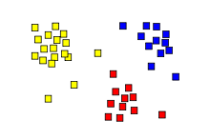
Clustering
Is a form of unsupervised learning that involves grouping a set of objects in a way that objects in the same group (cluster) are more similar than those in different groups
There are many types of clustering:
Connectivity-based clustering (Hierarchical clustering)
Centroid-based clustering (K-means clustering)
Distribution-based clustering (Expectation-Maximization EM clustering)
Density-based clustering (DBSCAN)
Applications:
Pattern recognitions
Data compression
Information retrieval
Image analysis

Slide 23
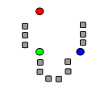
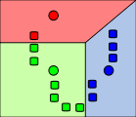
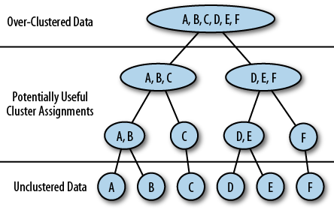
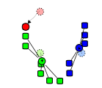
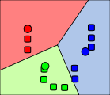
Types of Clustering
Hierarchical clustering
Connecting nearby objects to maximize minimum distance between clusters
Good when underlying data has a hierarchical structure (like the correlations in financial markets)
K-Means clustering
Group by minimizing the distance from each observation to the centre/mean of cluster it belongs to
Very efficient clustering algorithms and widely used

Slide 24
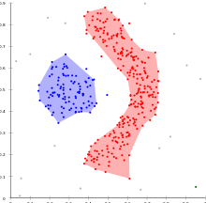
Types of Clustering
Expectation-Maximization (EM) clustering
Based on distribution models by finding the maximum likelihood parameters of the model
Used in portfolio management and risk modelling
Density-based clustering (DBSCAN)
Group together points that are closely packed together and mark low-density regions as outliers
No need to specify the number of clusters
Robust to outliers/noise
Can handle clusters of different shapes and sizes

Slide 25
Workshop Sessions
Bayesian Algorithms
Clustering
Dimensionality Reduction
Neural Networks
Model Selection & Evaluation
Classification
Decision Trees and Random Forests
Support Vector Machines
Regression
Generalized Linear Models
Ridge Regression (Regularization)

Slide 26
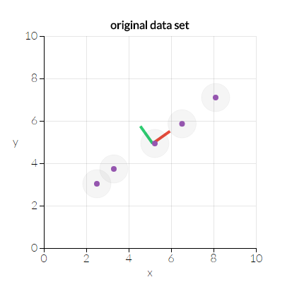

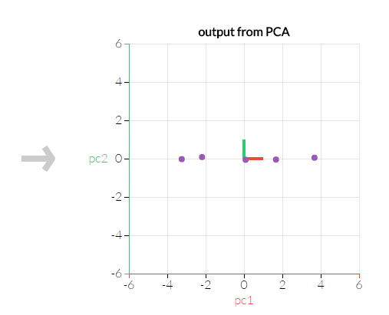
Dimensionality Reduction
Reduce the number of features either by finding a subset of the original variables (Feature Selection) or by transforming the data to a space of fewer dimensions (Feature Extraction)
Principal Component Analysis (PCA) is a statistical procedure to transform the data to a space of fewer dimensions that allow more variation (less correlation)

Slide 27
Workshop Sessions
Bayesian Algorithms
Clustering
Dimensionality Reduction
Neural Networks
Model Selection & Evaluation
Classification
Decision Trees and Random Forests
Support Vector Machines
Regression
Generalized Linear Models
Ridge Regression (Regularization)

Slide 28
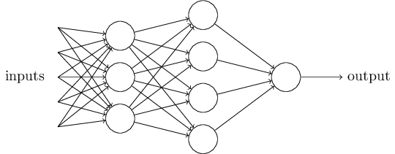
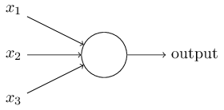
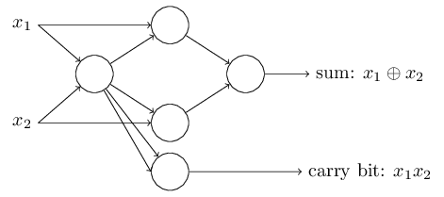
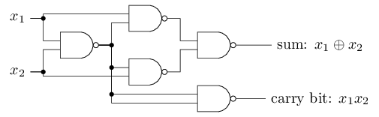
Neural networks
Machine learning models that are inspired by the structure and/or function of biological neural networks
They are a class of pattern matching that are commonly used for regression and classification

Slide 29
Workshop Sessions
Bayesian Algorithms
Clustering
Dimensionality Reduction
Neural Networks
Model Selection & Evaluation
Classification
Decision Trees and Random Forests
Support Vector Machines
Regression
Generalized Linear Models
Ridge Regression (Regularization)

Slide 30
Today’s Session
Pipeline: chaining estimators
Pipelines
FeatureUnion
Model Selection and Evaluation
Cross-validation: evaluating estimator performance
Tuning the hyper-parameters of an estimator
Model evaluation: quantifying the quality of predictions
Model Persistence
Validation curves: plotting scores to evaluate models

Slide 31
Workshop Sessions
Bayesian Algorithms
Clustering
Dimensionality Reduction
Neural Networks
Model Selection & Evaluation
Classification
Decision Trees and Random Forests
Support Vector Machines
Regression
Generalized Linear Models
Ridge Regression (Regularization)

